Slide 1
FMEA REVIEW AN AUTOMATED APPROACH
- N SRNIVASARAMANUJAM

Slide 2
FMEA REVIEW - AN AUTOMATED APPROACH
FMEA REVIEW – Conventional Approach
PPM Data of Rejection is used to calculate RPN value
Skilled professionals are required for RPN value determination
No awareness of major changes in RPN value to core team members

Slide 3
FMEA REVIEW - AN AUTOMATED APPROACH
FMEA REVIEW – Automated Approach
Production and Rejection data are used to calculate RPN value
Semi Skilled professionals are sufficient for RPN value determination
Alerts/Notifications are triggered on daily basis for major changes in RPN value to core team members

Slide 4
FMEA REVIEW - AN AUTOMATED APPROACH
FMEA REVIEW – Advantages of Automated Approach
Display of Pareto analysis for defects
High severity and High occurrences – in a separate view
Low detection and High occurrences – in a separate view
Option to hyperlink 8D analysis reports for complaints
Option to import from FMEA excel file

Slide 5
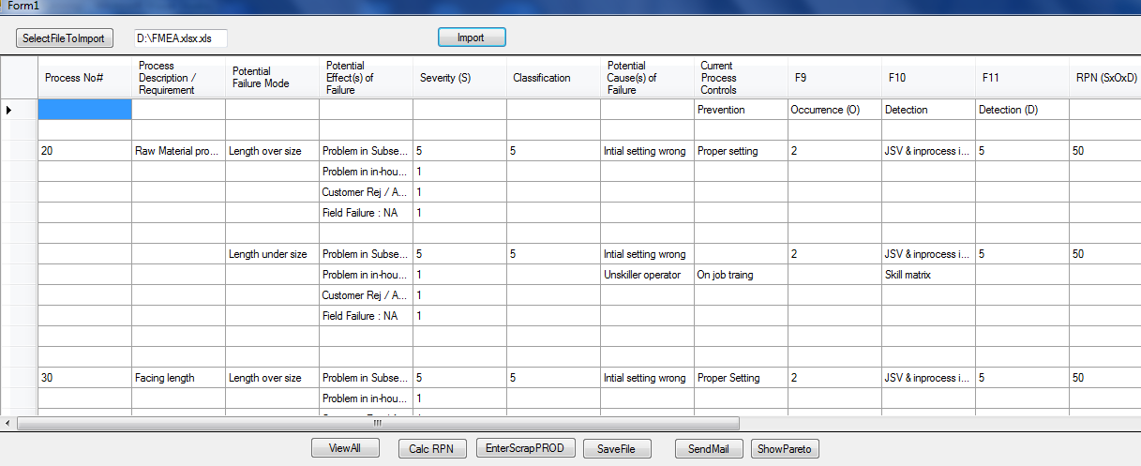
FMEA REVIEW - AN AUTOMATED APPROACH
Screenshot of FMEA excel file imported to application interface

Slide 6
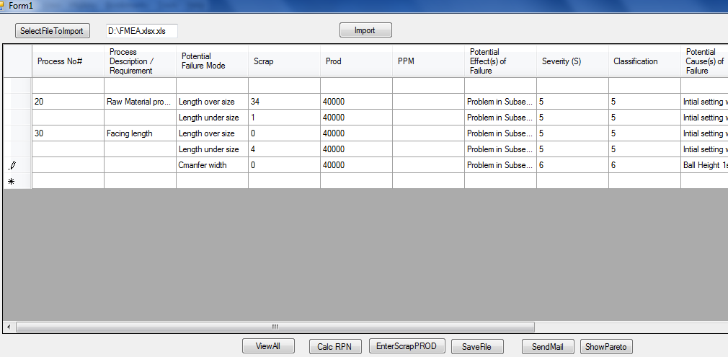
FMEA REVIEW - AN AUTOMATED APPROACH
Screenshot of Scrap and Production entry screen

Slide 7
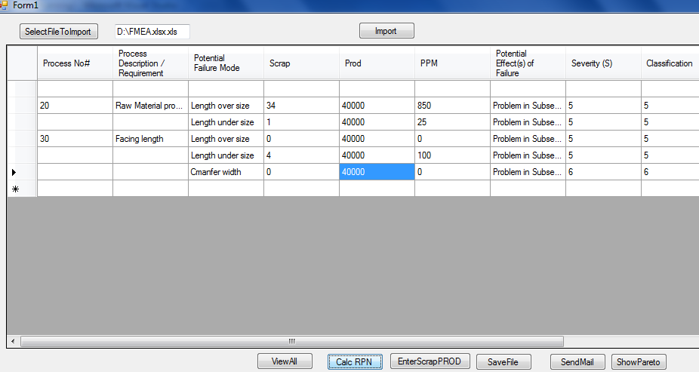
FMEA REVIEW - AN AUTOMATED APPROACH
Screenshot of PPM calculation

Slide 8
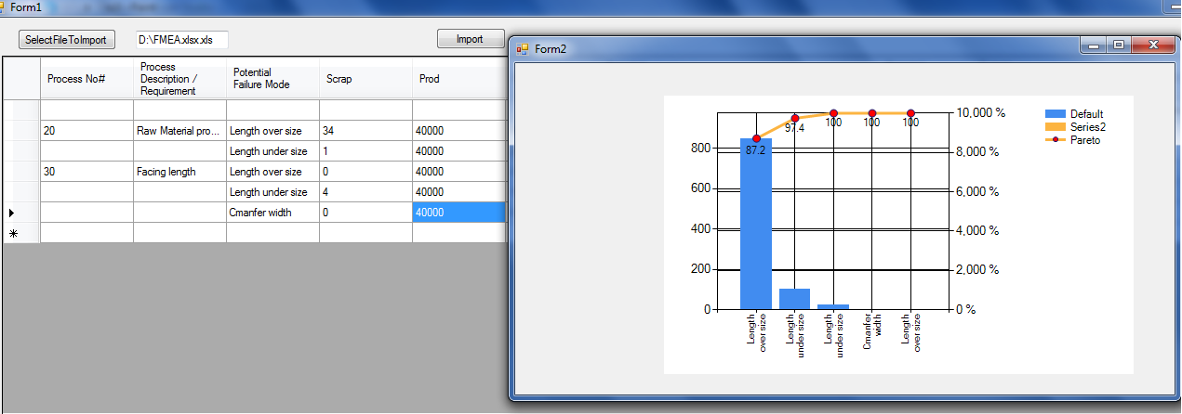
FMEA REVIEW - AN AUTOMATED APPROACH
Screenshot of Pareto Analysis for Rejection

Slide 9
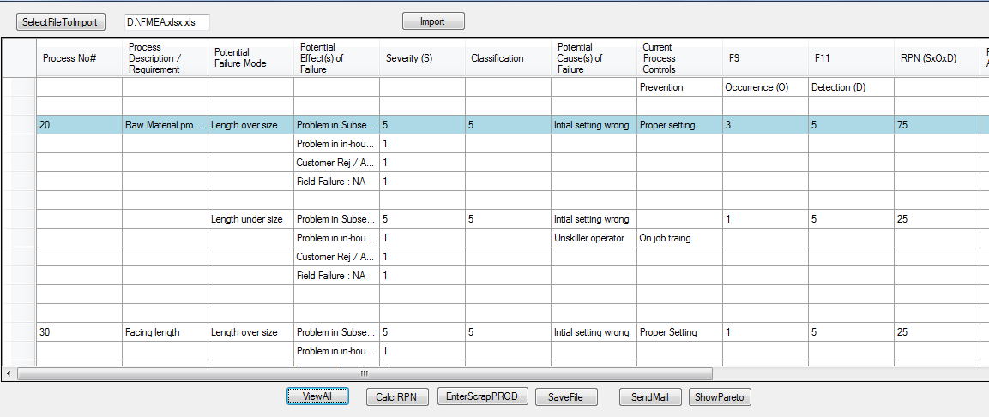
FMEA REVIEW - AN AUTOMATED APPROACH
Screenshot of FMEA after Highlighting Top RPN in Blue Color

Slide 10
FMEA REVIEW - AN AUTOMATED APPROACH
Further Thought’s to Improve the Application
Mail Will be Triggered for Core Team Members if PPM is more than the set Value of Target
Smart Phone Application to View and Edit FMEA by Core Team Members
8 D linkage to particular RPN place of Defect Phenomenon
Real time Production and rejection data linkage from ERP on daily basis

Slide 11
THANK YOU

